Slide 1

Career Zone
Interest Profiler
Use GOOGLE CHROME to complete this activity

Slide 2

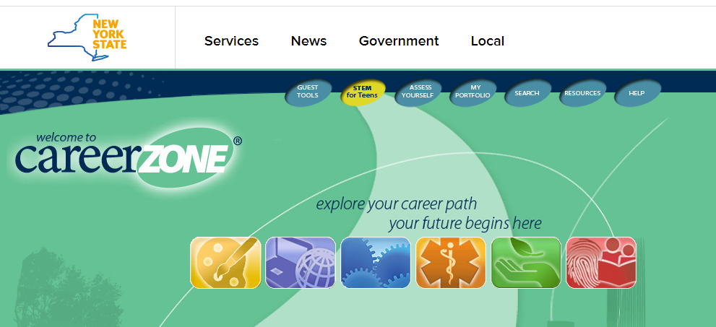
Click on My Portfolio

Slide 3
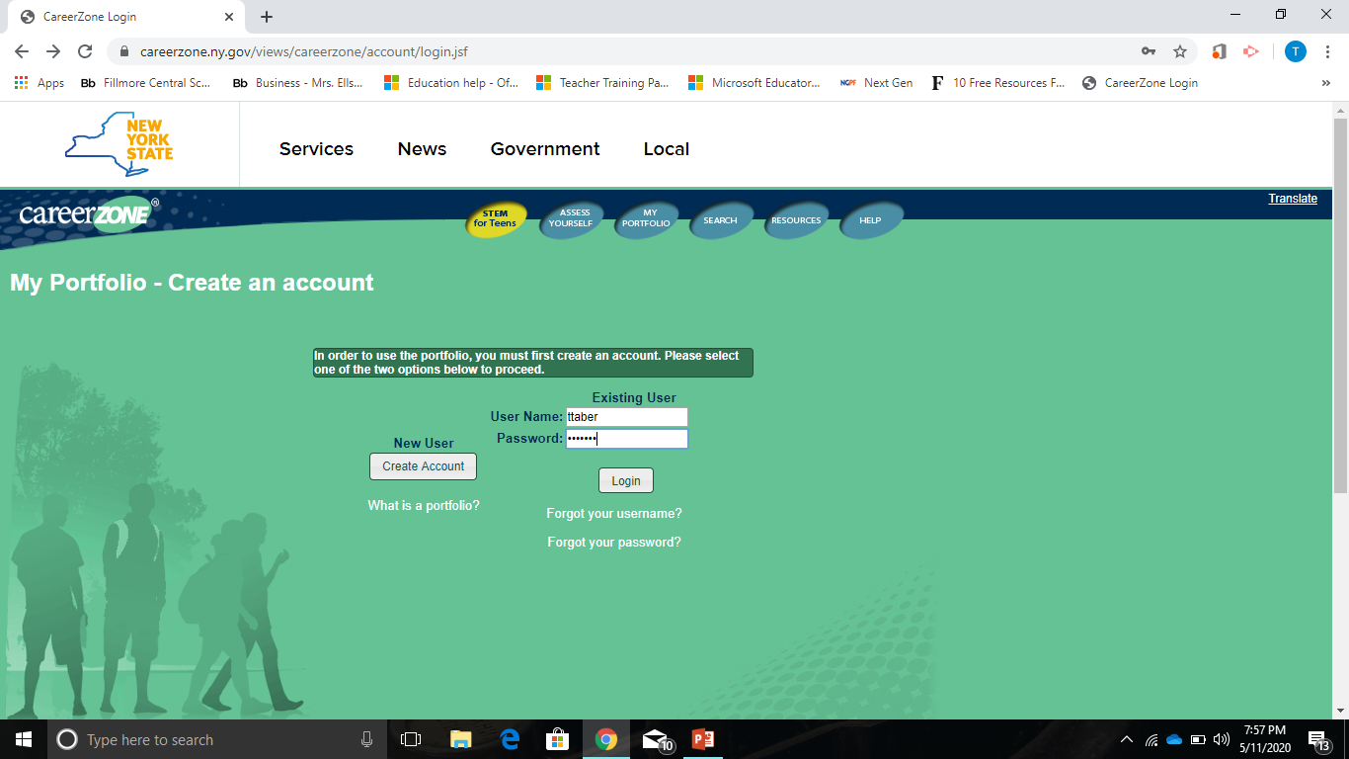
Log in with your information

Slide 4
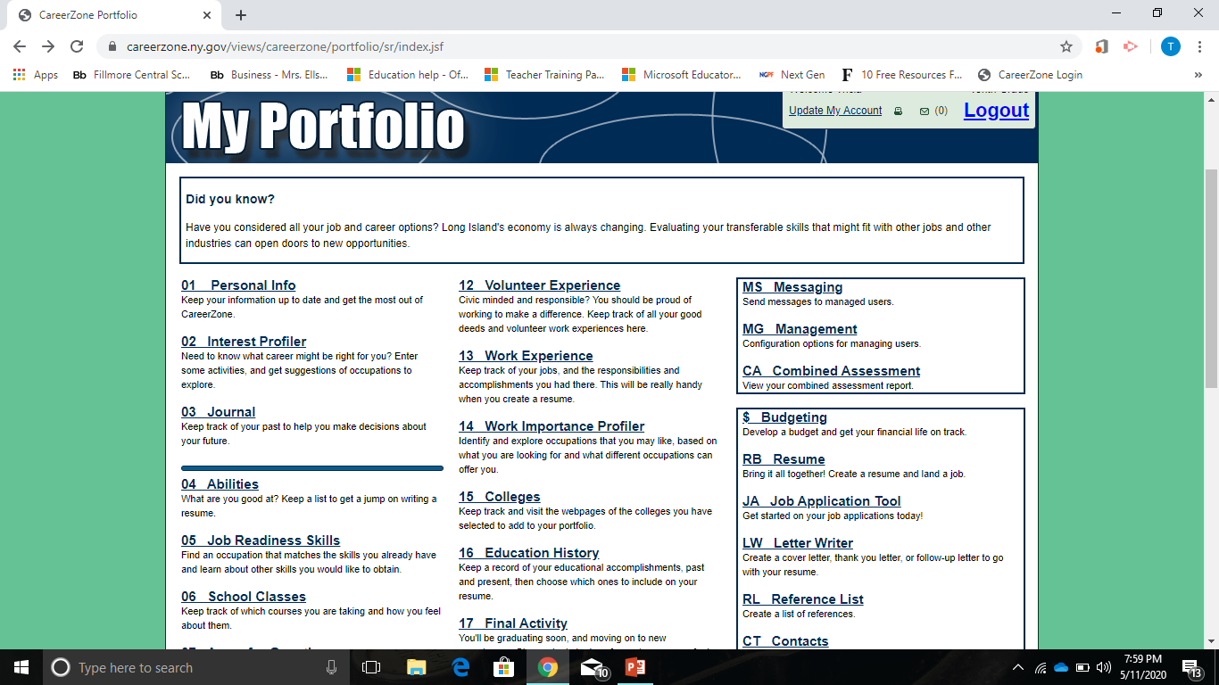
Access the Interest Profiler

Slide 5
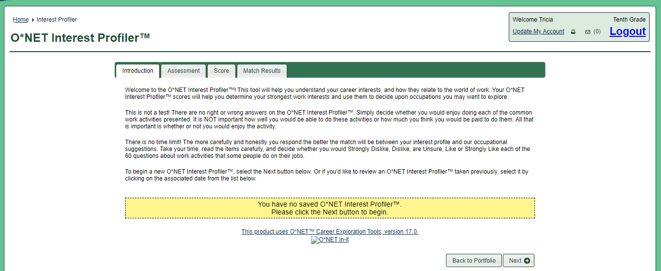
Need to know what career might be right for you? Enter some activities, and get suggestions of occupations to explore.
Introduction Tab
At the bottom right, Click Next

Slide 6
Assessment Tab
Find careers that match your work values.
For each question, try not to think about whether or not you have enough education or training to do the work, or how much money you would make doing it.
Instead, just focus on whether you would like or dislike performing the task.
There are 5 Parts.
  Complete each part
    1 of 5, click next
    2 of 5, click next
    3 of 5, click next
    4 of 5, click next
    5 of 5

Slide 7
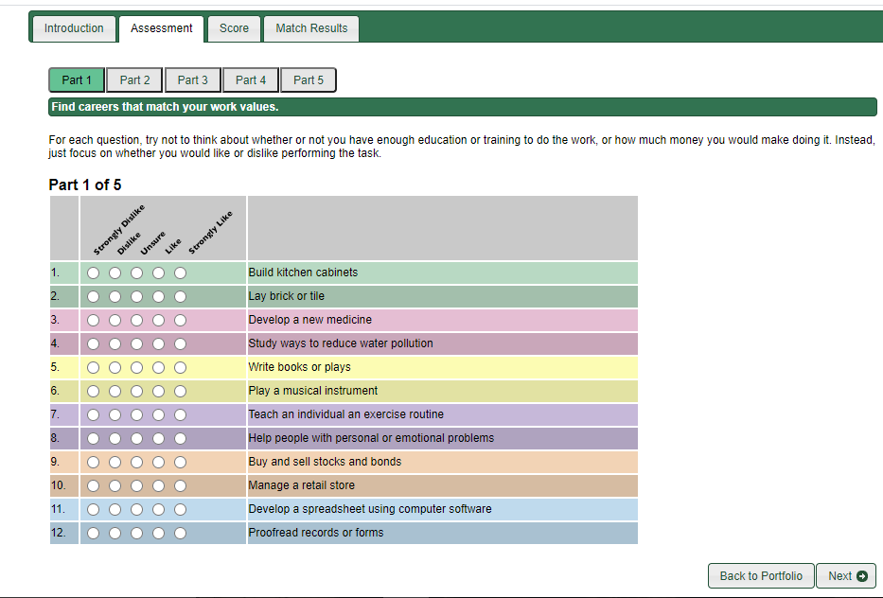
Part
1 of 5

Slide 8

Part
2 of 5

Slide 9
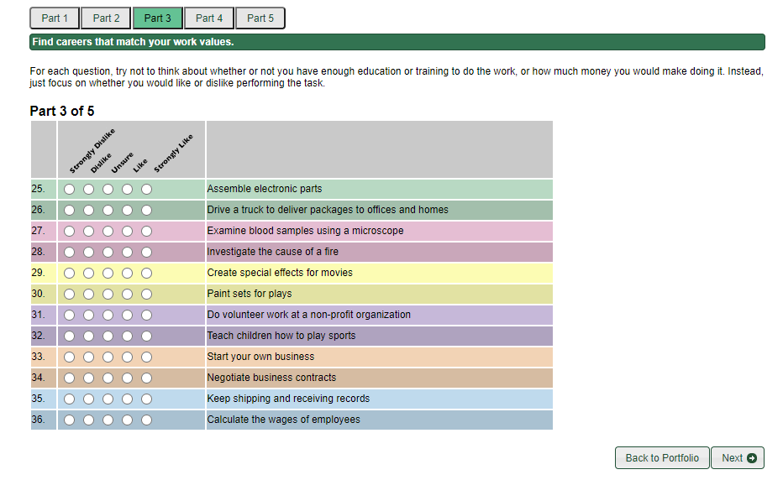
Part
3 of 5

Slide 10
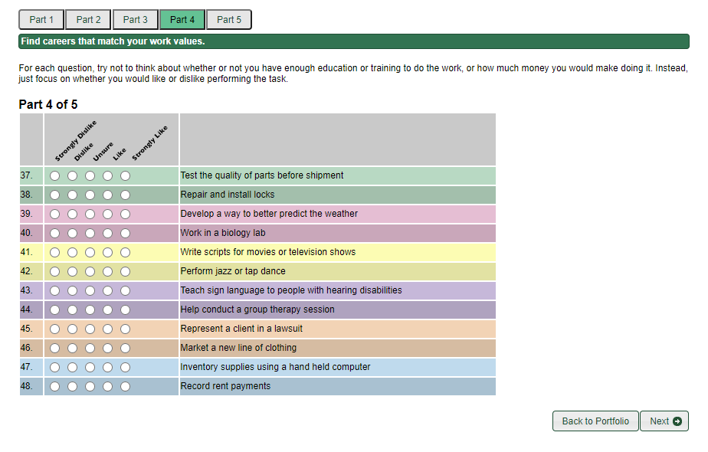
Part
4 of 5

Slide 11
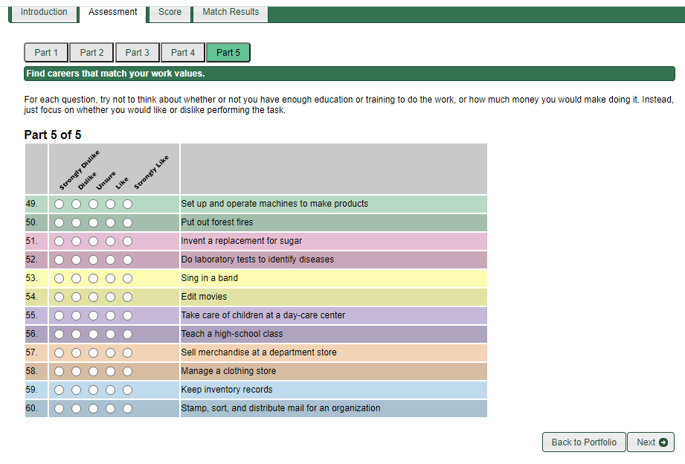
Part
5 of 5

Slide 12
Score Tab
Point to and click an interest area for its definition,
  or click Next to see your interest profile matches.
The scores below are a summary of your interests; they represent how much you enjoy each type of activity.
The three highest scoring areas form an interest profile that can be used to explore occupations.
These results should be considered a guide for your career exploration, not a definitive statement of which occupations you should or should not pursue.
The results do not mean that you will be good at a particular occupation, only whether you might enjoy the type of activities required by that occupation.

Slide 13
Match Occupations
Your interests returned the following occupations.
Three stars 3 stars represent the strongest matches.
Two stars 2 stars represent strong matches.
One star 1 star represents a weak match.

Slide 14
Look at the 5 Job Zones
Job Zone 1
  Little or no previous work-related skill, knowledge, or experience is needed for these occupations. For example, a person can become a waiter or waitress even if he/she has never worked before.
Job Zone 2
  Some previous work-related skill, knowledge, or experience is usually needed. For example, a teller would benefit from experience working directly with the public.
Job Zone 3
  Previous work-related skill, knowledge, or experience is required for these occupations. For example, an electrician must have completed three or four years of apprenticeship or several years of vocational training, and often must have passed a licensing exam, in order to perform the job.
Job Zone 4
  A considerable amount of work-related skill, knowledge, or experience is needed for these occupations. For example, an accountant must complete four years of college and work for several years in accounting to be considered qualified.
Job Zone 5
  Extensive skill, knowledge, and experience are needed for these occupations. Many require more than five years of experience. For example, surgeons must complete four years of college and an additional five to seven years of specialized medical training to be able to do their job.

